Slide 1
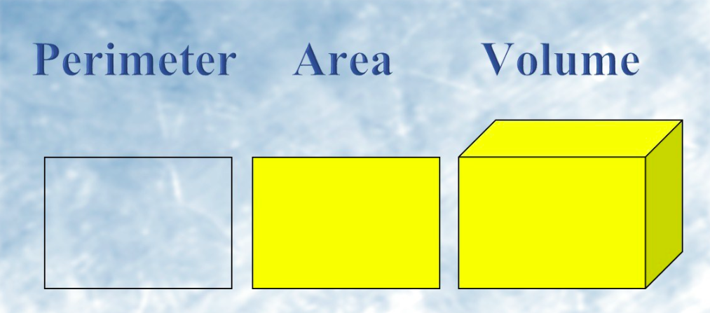
Area, perimeter and volume
By Sally Anne Grimley

Slide 2
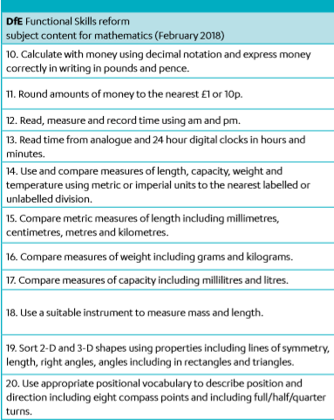
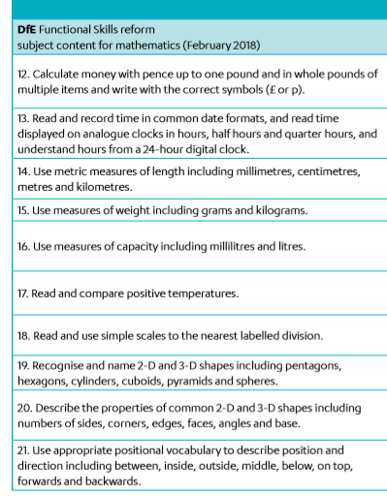
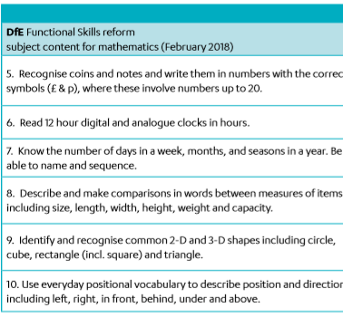
Common Shape and Space
Entry 3
Entry 2
Entry 1

Slide 3
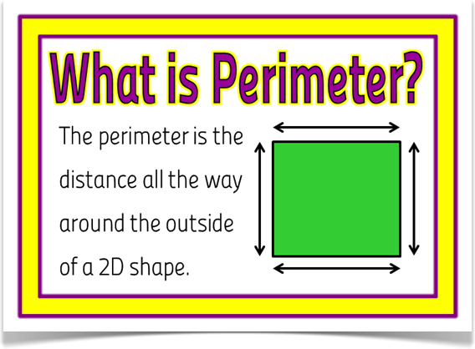
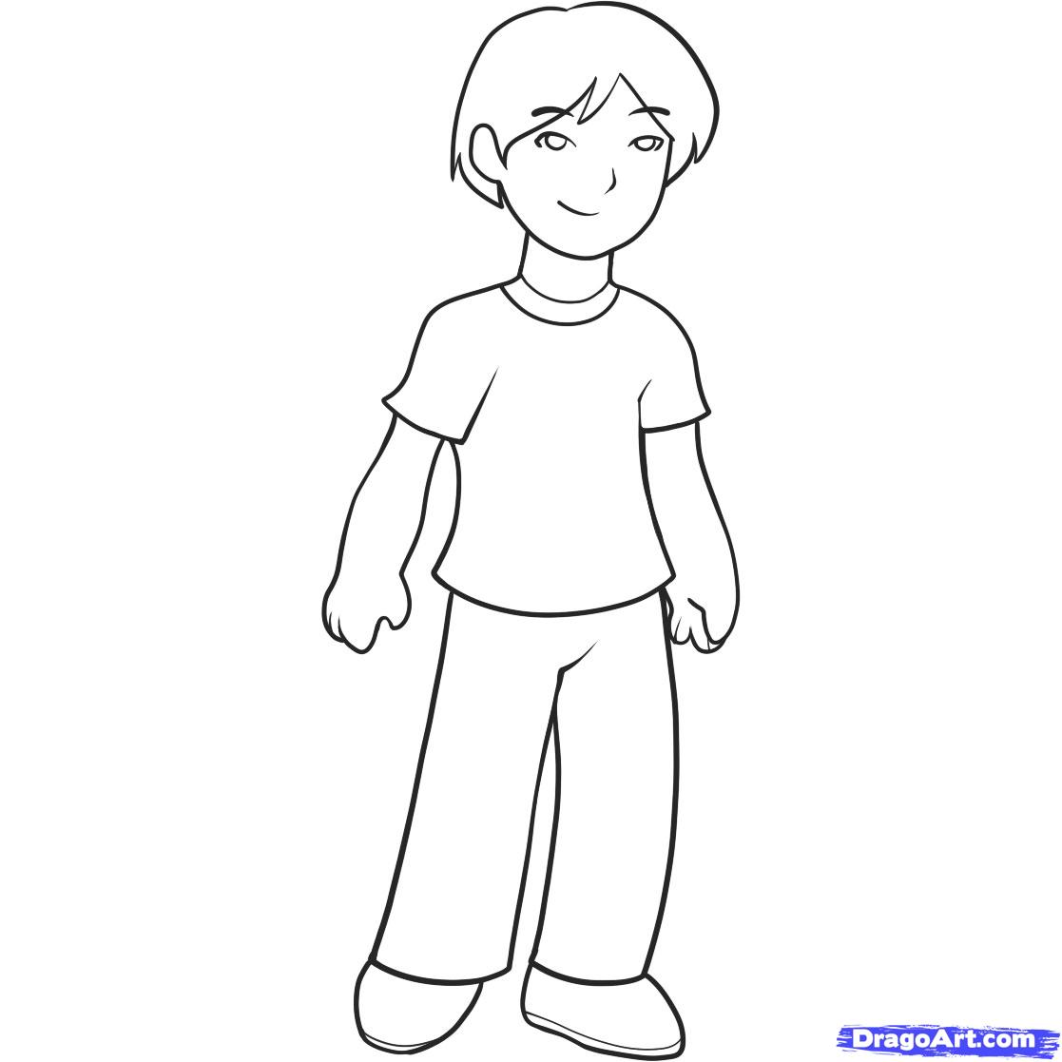
SQUAREs- STRAIGHT EDGES
15m
20m
20m
15m
Lionel walks around the edge of the park. To calculate the distance he has walked (PERIMETER) he would add all of the sides together.
20m + 15m + 20m + 15m = 70m

Slide 4
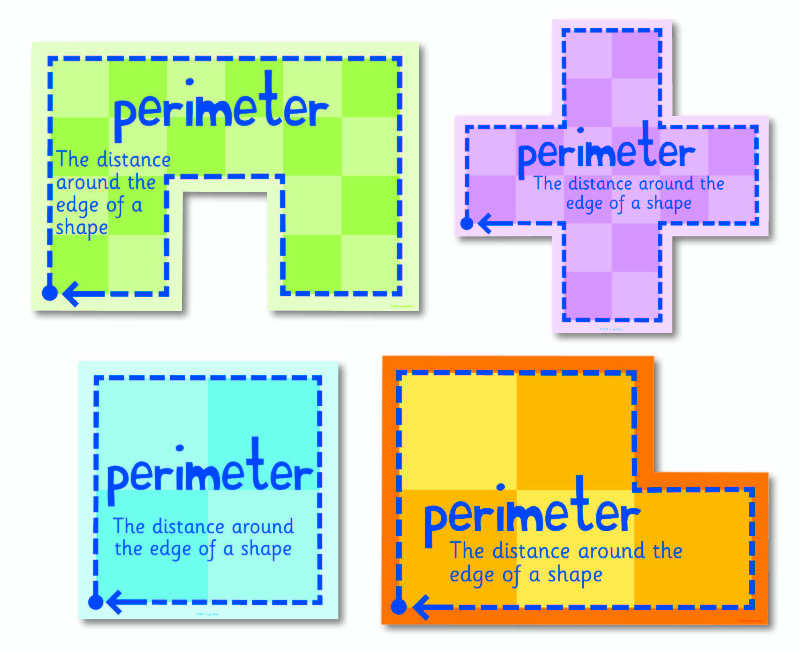
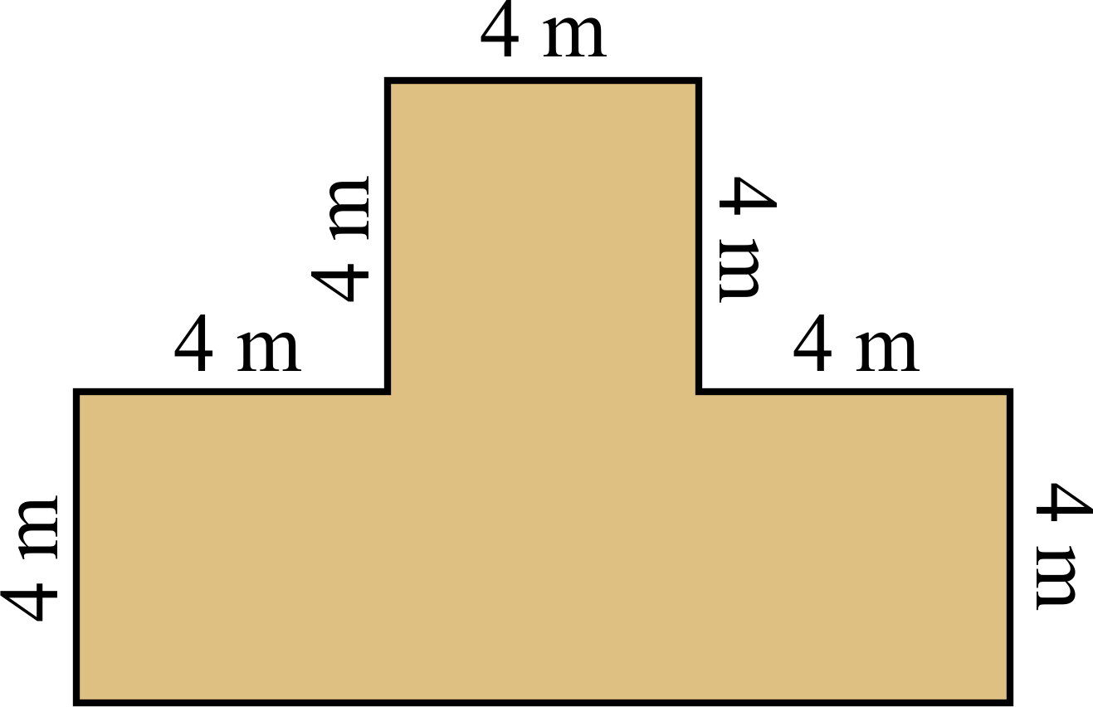

Shapes can be all different sizes and may have some measurements missing!
What would this edge of the shape measure?

Slide 5
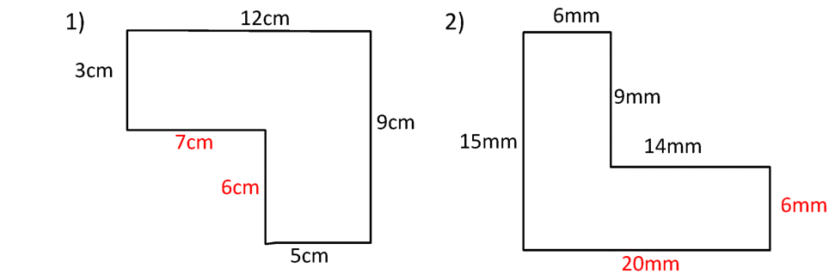
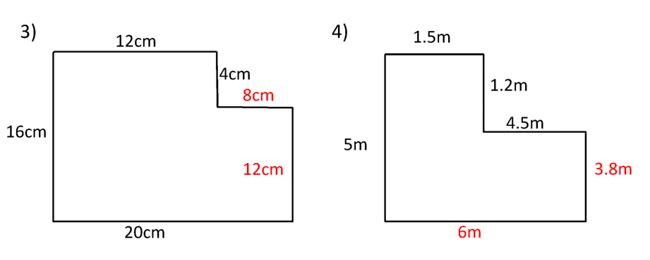
Scale Drawings – Activity
Entry 3
Work out the perimeter of the following shapes
Don’t forget to show the unit

Slide 6
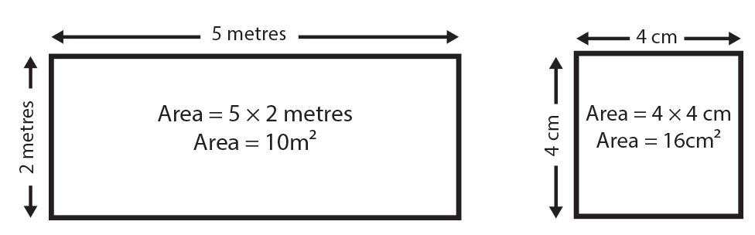
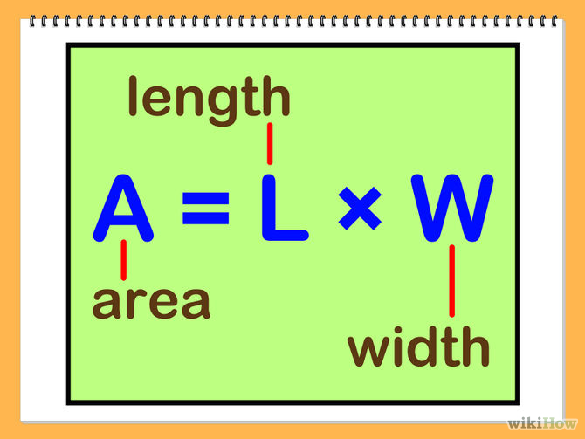
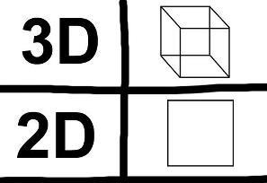
Area
3D shapes are followed by = ³
2D shapes are followed by = ²

Slide 7
How would you
calculate the area
of this shape?

Slide 8
8m x 4m = 32m²
4m x 4m = 16m²
4m x 4m = 16m²
Answer
4m + 4m + 4m = 12m
16m² + 32m² + 16m²
= 64m²

Slide 9
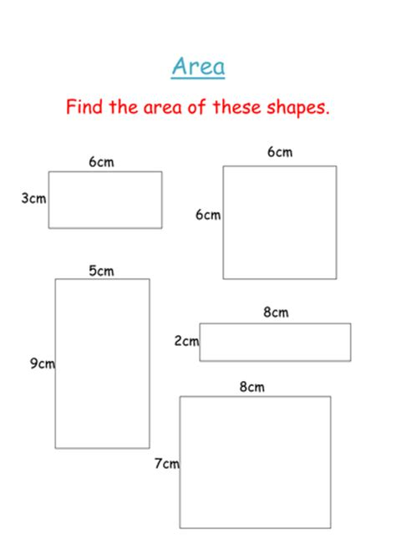
Scale Drawings – Activity
Entry 3

Slide 10
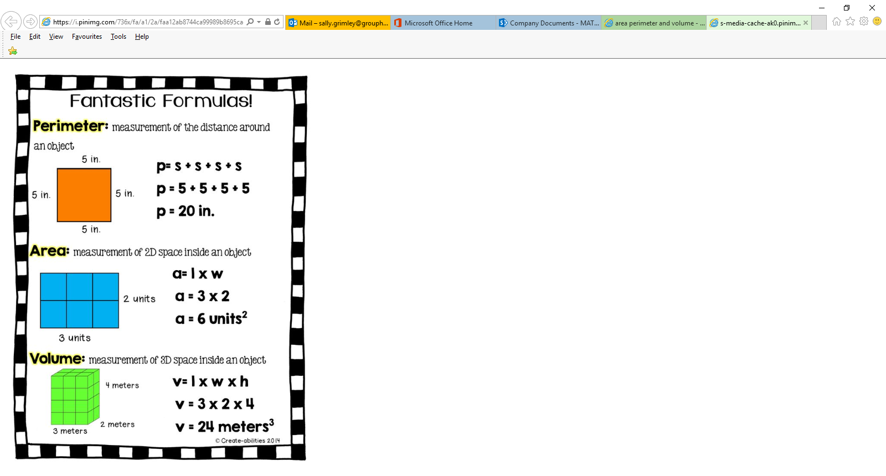
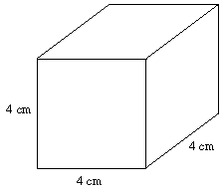
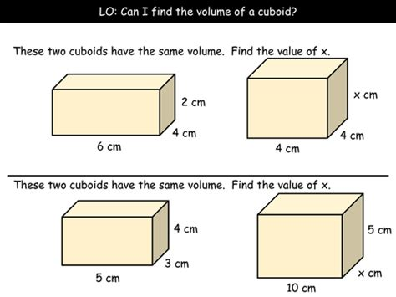
What is
the volume?

Slide 12
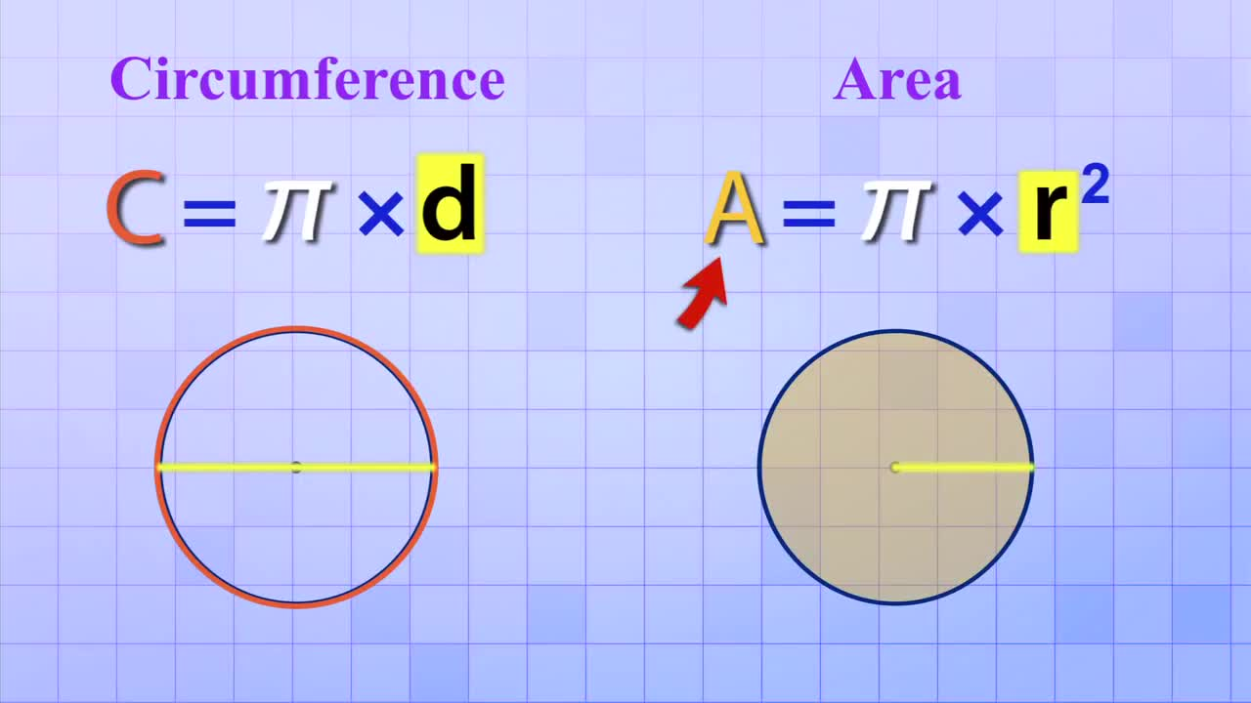
Lesson Aim: To be able to interpret scale measurements and use given information to carry out scale drawings.
Entry 3 Objectives:
All Learners will be able to:
Calculate the perimeter of a shape with straight edges.
Calculate the area of a 2D shape with straight edges.
Key activities today: Key tasks/outcomes today will look like this:

