Slide 1

Entry 1 Entry 2 Entry 3 Functional Skills Maths
Introduction

Slide 2
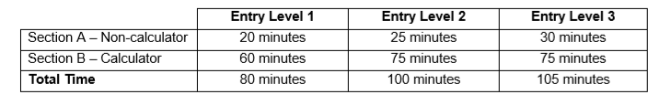
Qualification structure:
The controlled assessment is divided into 2 sections: • Section A: The non-calculator section • Section B: The calculator section

Slide 3
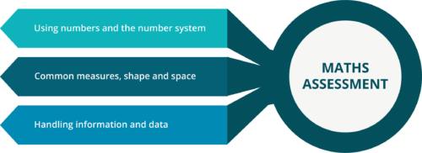

Slide 4
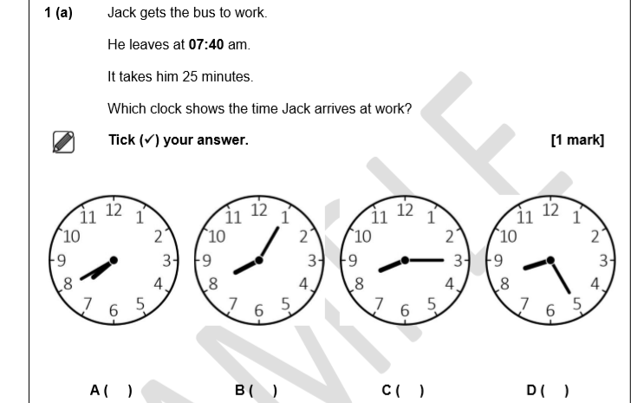

Slide 5
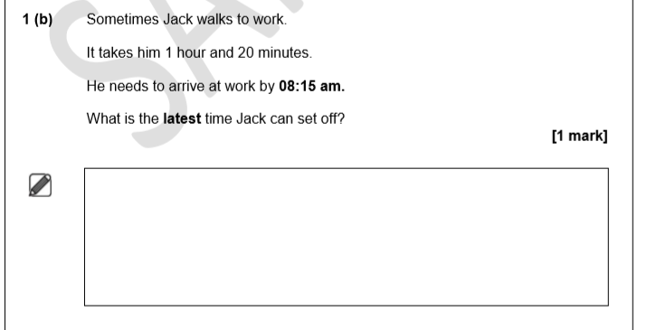

Slide 6
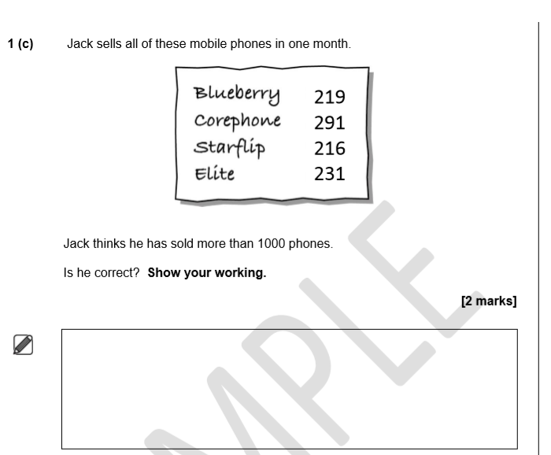

Slide 7
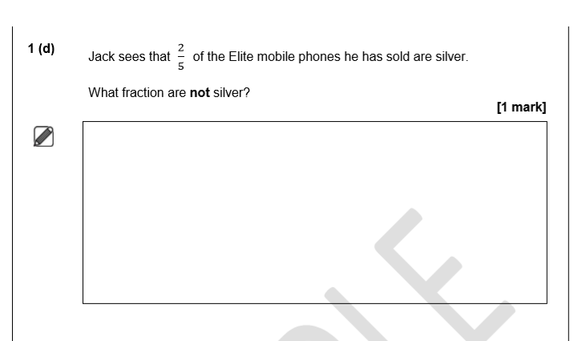

Slide 8
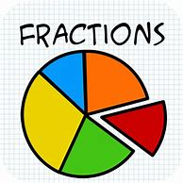
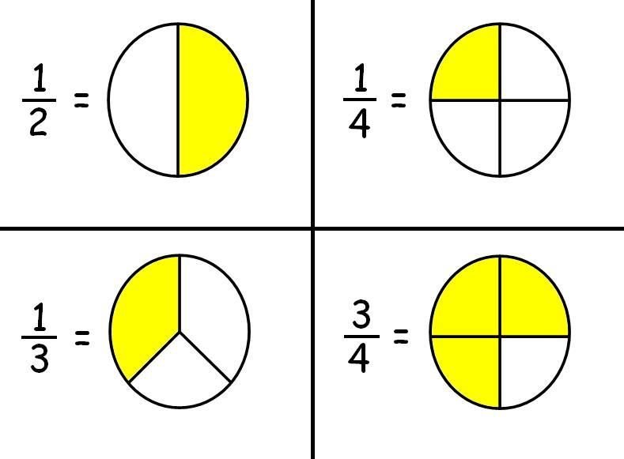
Fractions
Denominator
numerator
N
D

Slide 9


Slide 10
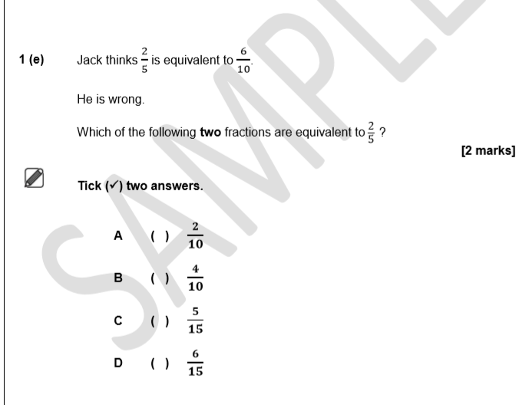
https://www.youtube.com/watch?v=VTCGuAdbQKE

Slide 11
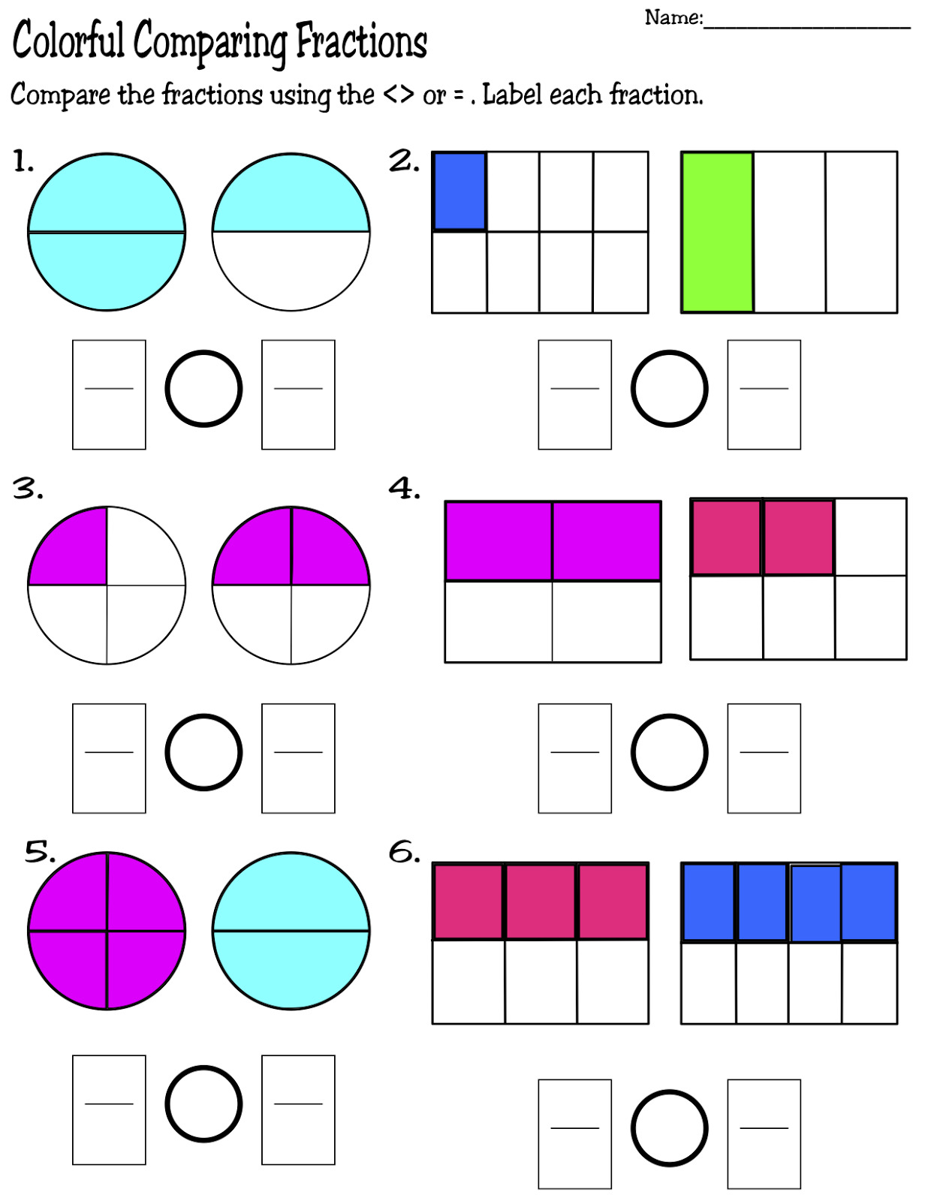

Slide 12
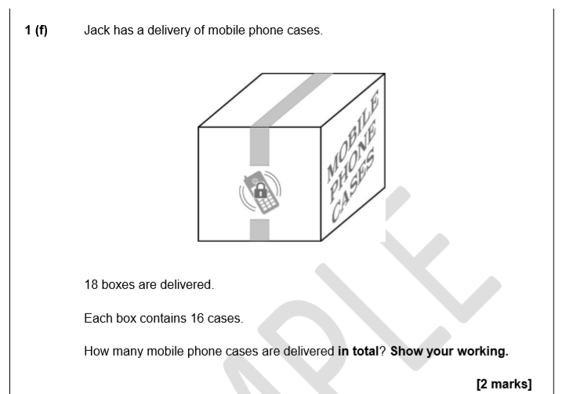

Slide 13
WORKING OUT:
18
16
x

Slide 14
