Slide 1
Entry 1, Entry 2, Entry 3 Functional Skills English
Introduction lesson- week 2
Sally- Anne Grimley

Slide 2
Agenda today and tomorrow
Today
Speaking and listening assessment- breakdown
Time to prep for speaking and listening
Group for speaking and listening
Maths none calculator exam- have a look
Tomorrow
Carry out speaking and listening assessment in groups
Complete none calculator maths exam

Slide 3
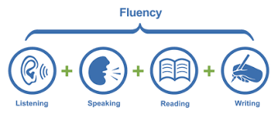
Qualification structure:
The following components are internally assessed:
• Speaking, Listening and Communicating
• Reading
• Writing – spelling test/ Alphabet order

Slide 4
Entry Levels NCFE
Speaking & Listening

Slide 5
Speaking, Listening and Communicating (SLC)

Slide 6
Speaking and Listening- what are they assessing? Entry 1

Slide 7
Entry 2

Slide 8
Entry 3

Slide 9
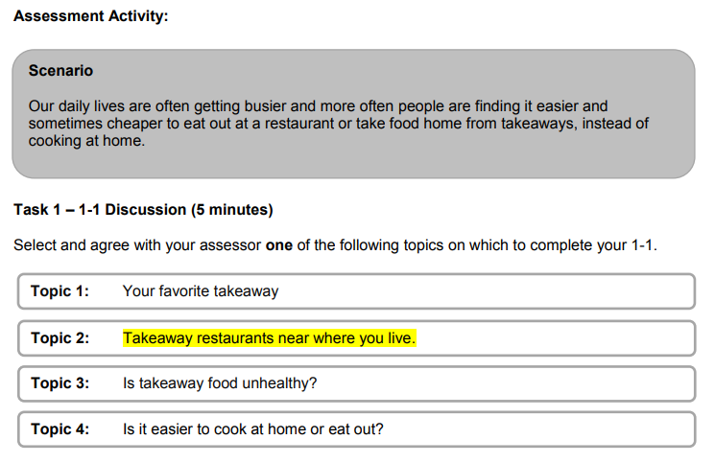
Entry Level 1: Structure
In addition to the Assessment Activity, there are also Assessor Notes provided during the assessment to ensure that the learner has the opportunity to:
Respond to an instruction
Say the names of some of the letters of the alphabet
Respond to straightforward questions

Slide 10
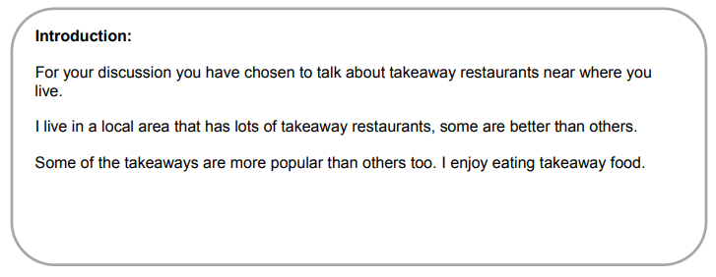
Entry Level 1: Assessor Notes
F
B
During the discussion, ask the learner questions about the topic.
Say the names of the alphabet
During the discussion with your learner, you will need to complete each of the following:
Ask the learner to follow a single step instruction
F
Introduce the Topic

Slide 11
Entry Level 2: Structure
The SLC assessment for Entry Level 2 is broken down as follows:
The scenario and topic must be given to the learner directly prior to the assessment taking place on the same day.
There is an optional preparation time of up to 30 minutes for the learner to prepare for their discussion directly before the assessment takes place.
Task | Task Content | Duration
1 | 1-1 discussion The learner is provided with a choice of topics. The learner completes a 1-1 discussion with the Assessor. | 5 minutes
2 | Group discussion A group of a minimum of 3 learners are instructed to discuss a topic designed to elicit discussion. | 2 – 3 minutes per learner

Slide 12
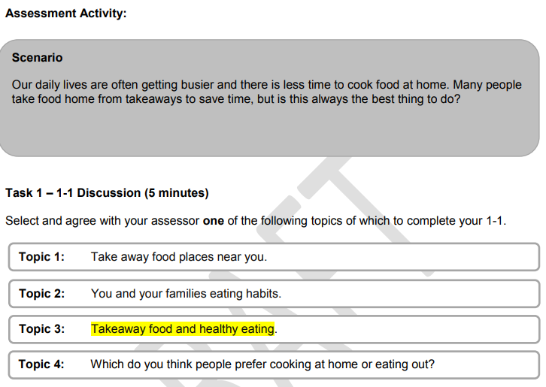
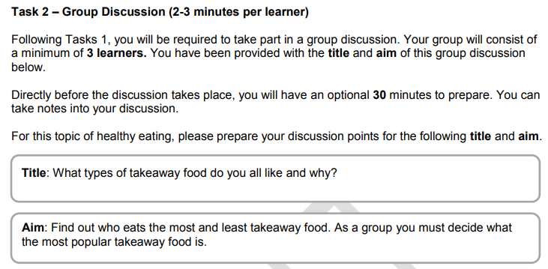
Entry Level 2: Structure

Slide 13
Entry Level 3: Structure
The SLC assessment for Entry Level 3 is broken down as follows:
Learners are allowed 2 hours to research and prepare for their discussions. This preparation and research must take place within the centre.
A further 20 minutes of optional preparation time is allowed for the learner to prepare directly before each group discussion takes place.
Task | Task Content | Duration
1 | Group discussion A group of a minimum of 3 learners are instructed to discuss a topic designed to elicit discussion. | 4 – 6 minutes per learner
2 | Group discussion A group of a minimum of 3 learners are instructed to discuss a topic designed to elicit discussion. | 4 – 6 minutes per learner

Slide 14
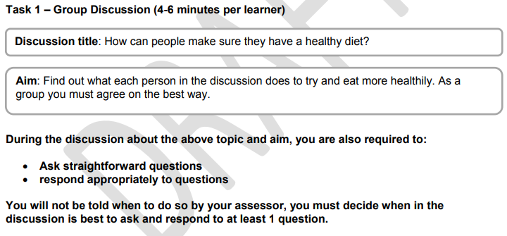
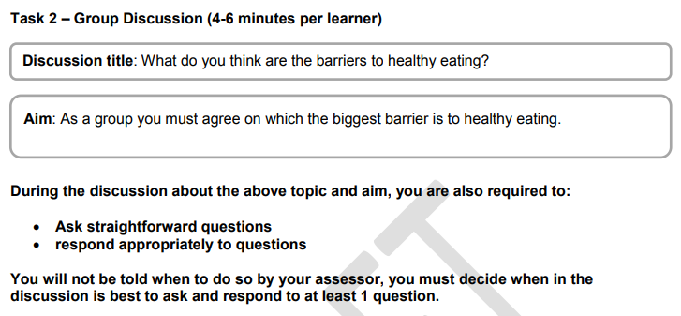
Entry Level 3: Structure

