Slide 1
Entry 1, Entry 2, Entry 3 Functional Skills English
Introduction lesson- week 1
Tutor

Slide 2
Group Students
Entry 1
Entry 2
Entry 3

Slide 3
About this qualification:
The purpose of Functional Skills English Entry Level qualifications are to demonstrate the ability at an appropriate level to read, write, speak, listen and communicate in English, and to apply this knowledge and these skills in familiar situations.

Slide 4
Who is it suitable for?
Functional Skills qualifications in English at Entry Level are ideal for learners wishing to develop practical, transferable skills in English in order to work confidently, effectively and independently in life.
It is suitable for a wide range of individuals and is fundamental to the successful completion of various wider qualifications and frameworks, such as Foundation Learning.

Slide 5
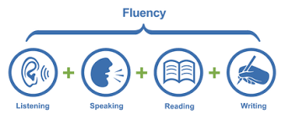
Qualification structure:
The following components are internally assessed:
• Speaking, Listening and Communicating
• Reading
• Writing – spelling test/ Alphabet order

Slide 6
Speaking, Listening and Communicating (SLC)
We will look more
at this later..

Slide 7
Speaking and Listening- what are they assessing?
Entry 1
Entry 2
Entry 3

Slide 8
Reading and Writing + spelling exam

Slide 9
Reading
Entry 1
Entry 3
Entry 2

Slide 10
Writing
Entry 2
Entry 1

Slide 11
Writing Entry 3

Slide 12
8 Week Course Structure
Week 1- Introduction/ Initial Assessments. Begin preparation for Speaking and Listening. Start spelling exam preparation.
Week 2-Speaking and Listening EXAM
Week 3-Reading
Week 4-Reading/ mock reading exam
Week 5-Feedback for reading exam/ Writing
Week 6-Writing/ mock writing exam
Week 7-Feedback from writing exam- final prep
Week 8- FINAL EXAMS

Slide 13
Entry Levels NCFE
Speaking & Listening

Slide 14
Speaking, Listening and Communicating (SLC)

Slide 15
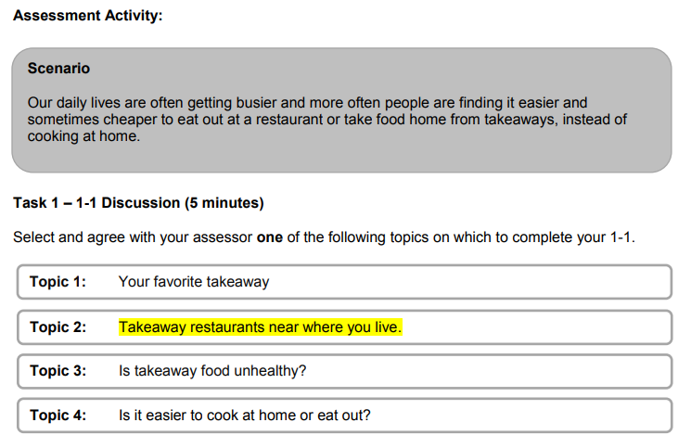
Entry Level 1: Structure
In addition to the Assessment Activity, there are also Assessor Notes provided during the assessment to ensure that the learner has the opportunity to:
Respond to an instruction
Say the names of some of the letters of the alphabet
Respond to straightforward questions

Slide 16
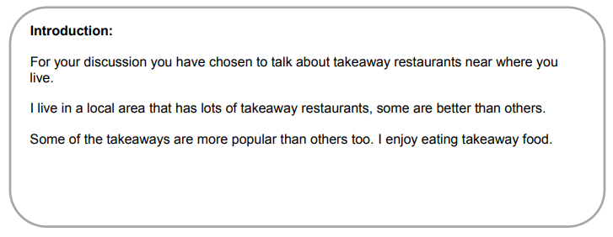
Entry Level 1: Assessor Notes
F
B
During the discussion, ask the learner questions about the topic.
Say the names of the alphabet
During the discussion with your learner, you will need to complete each of the following:
Ask the learner to follow a single step instruction
F
Introduce the Topic

Slide 17
Entry Level 2: Structure
The SLC assessment for Entry Level 2 is broken down as follows:
The scenario and topic must be given to the learner directly prior to the assessment taking place on the same day.
There is an optional preparation time of up to 30 minutes for the learner to prepare for their discussion directly before the assessment takes place.
Task | Task Content | Duration
1 | 1-1 discussion The learner is provided with a choice of topics. The learner completes a 1-1 discussion with the Assessor. | 5 minutes
2 | Group discussion A group of a minimum of 3 learners are instructed to discuss a topic designed to elicit discussion. | 2 – 3 minutes per learner

Slide 18
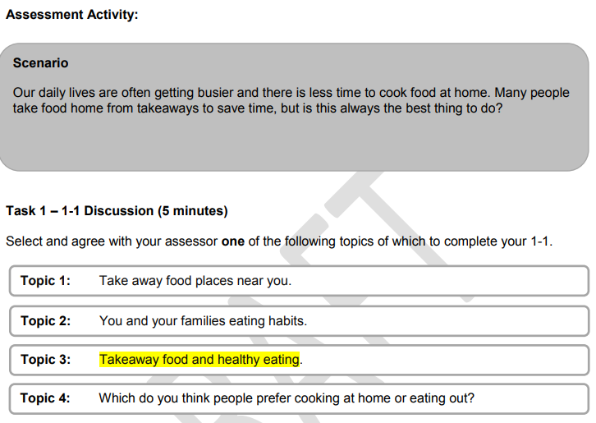
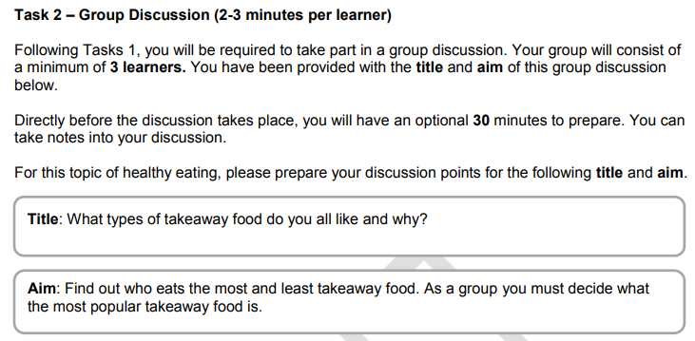
Entry Level 2: Structure

Slide 19
Entry Level 3: Structure
The SLC assessment for Entry Level 3 is broken down as follows:
Learners are allowed 2 hours to research and prepare for their discussions. This preparation and research must take place within the centre.
A further 20 minutes of optional preparation time is allowed for the learner to prepare directly before each group discussion takes place.
Task | Task Content | Duration
1 | Group discussion A group of a minimum of 3 learners are instructed to discuss a topic designed to elicit discussion. | 4 – 6 minutes per learner
2 | Group discussion A group of a minimum of 3 learners are instructed to discuss a topic designed to elicit discussion. | 4 – 6 minutes per learner

Slide 20
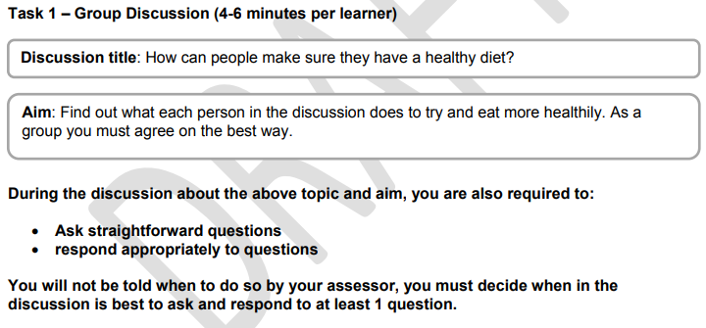
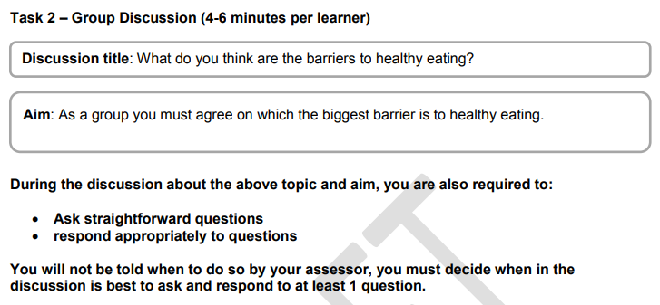
Entry Level 3: Structure

Slide 21
Complete initial assessment
Please do not put a date on the initial assessment
Please only put on your name and signature
If you have completed the initial assessment
- Practice spelling exam

Slide 22
Part 1

Slide 23
Order letters- Alphabet
Part 2

Slide 24
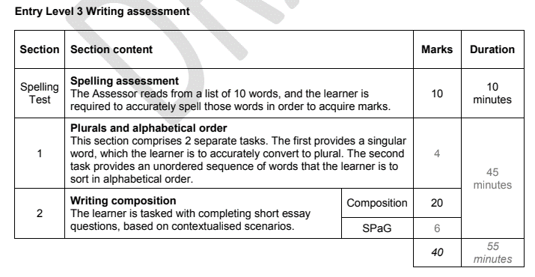
Assessment Update Entry 2 and Entry 3
Entry Level Writing Assessments
Spelling assessment must be completed before the Writing assessment. These can also take place on two different dates.
Two separate sections, with Section One based on Alphabetical Order (and Plurals – EL2/3) and Section Two focussed on writing compositions.

Slide 28
Tutor use;
https://www.qualhub.co.uk/media/11022/el1-3_spelling-test_set-1_fs-watermarked.pdf
Print this off.
Assessor instructions •
Firstly read out the learner instructions below. •
Read out each word.
Read the sentence that puts the word into context.
Repeat the word.
Give a pause for the learner to write the correct spelling on their sheet.

Slide 29
Spelling answers
Entry 1
Act
Wrote
Live
White
Too
Child
Over
Floor
After
Person
Entry 2
Address
Fruit
Animal
Imagine
Build
Complete
Strange
Extreme
Quiet
Music
Entry 3
Accept
Occasion
Criticise
Autumn
Knee
Although
Frequently
Particular
Communicate
Brought

Slide 30
Entry 1

Slide 31
Test Entry 2 & 3

